Slide 1
Site Map
Summary information about a temple
Call to action
HOME PAGE
Weather
The Temple page
The Reservation page
The Services page
special services offered
providing information
(ADMINISTRATIVE)
form
The reception page
full-time temple missionary page
Location
date
number and type of rooms
registrant's full name
email
phone
home state or country
special accommodations
Address,
Telephone
email
services
history
ordinance schedule
session schedule
temple closure schedule.
wedding reception accommodations
Food service and setup.
suites offered
Contact Us form

Slide 2
Site Purpose
The purpose of the website is to promote and provide information about the specialized services that this hotel chain offers to meet the needs of temple patrons who come to serve in the temple or who participate in events such as sealings, weddings, receptions, and youth trips.
Target Audience
The target audience will be temple workers, patrons, people, couples that are planning to marry and need specialized services and accommodations for families , people from the church from the world that are planning to visit different countries and need accomodations . The hotel accommodations and services are available to anyone willing to abide by the terms and policies outlined by the company.
Personnas:
The Wellness Seeker
Occupation: Worker and proffesionals from the church and guests.
Demographics and education: 35-45 years old.
Goal and motivations for using the site: To book a reservation rooms knowing that the hotel has the values of the church.
Social: Very active individuals, who likes to help people from his community.
Environment: They expect healthy menu items and access to a fitness center, and looking for mindful wellness will expect a meditation room .

Slide 3
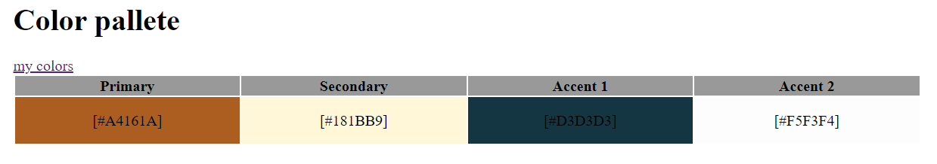
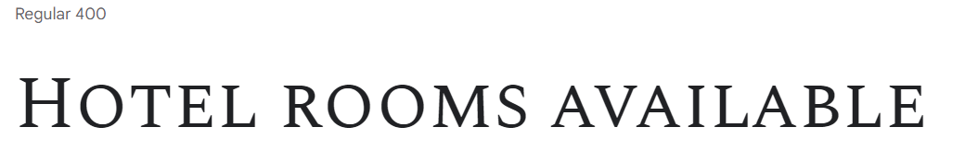
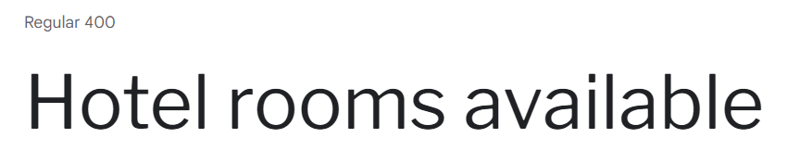
#664c13
fcefb4
TYPOGRAPHY
font-family: 'Spectral SC', serif;
2. Font-family:'Libre Franklin', sans-serif;

Slide 4

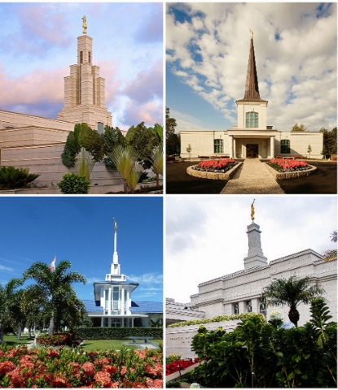

“Enjoy your relax”
BIG DISCOUNTS ON ALL RESERVATIONS

Slide 5


Slide 6

H

Slide 7

“Enjoy your relax”
BIG DISCOUNTS ON ALL RESERVATIONS

Slide 8


